Slide 1
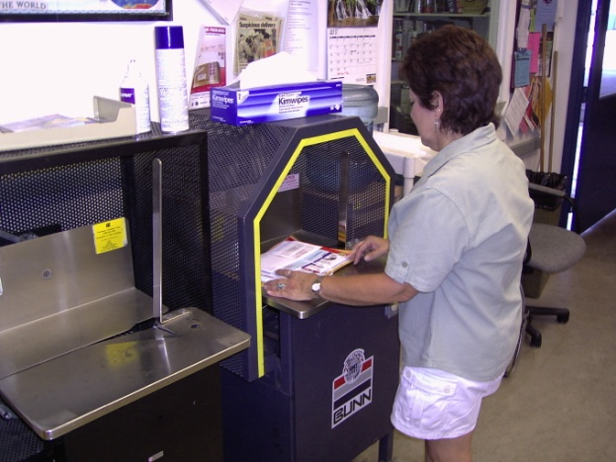
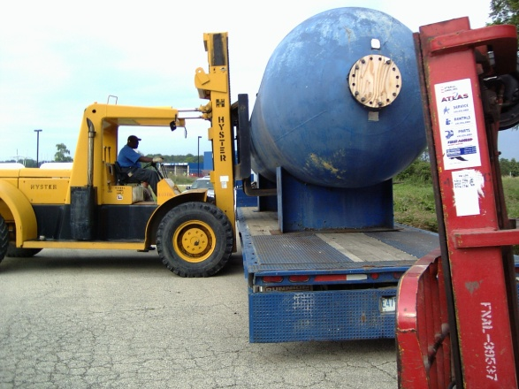
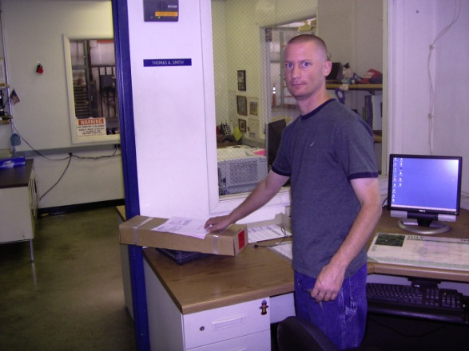
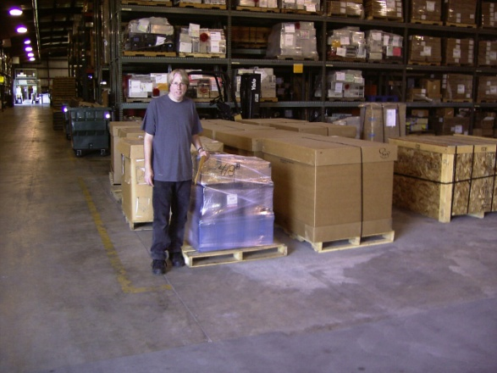
Fermilab Distribution

Slide 2
Receiving
6 Employees
Processed 30,000 packages in 2010
Unload freight/supplies from approximately 20 trucks a day
Unload approximately 120 small packages from UPS and FedEx daily
Deliver small packages to Wilson Hall

Slide 3
Mailroom
2 Employees
Process 254,000 pcs incoming mail
120 delivery locations on site
Outgoing Mail
Process 148,000 pcs domestic mail
Process 8,170 lbs foreign mail

Slide 4
Distribution
9 Employees
1 Bus operation
5 Trac/Trailer operators
3 Heavy straight truck operators
Furniture
Steel (plates, blocks, posts, building mtrls)
Concrete blocks
Magnets
Pumps, compressors, generators
Forklifts, manlifts
Trailers
On-site freight and package delivery
3 day route to Argonne Nat Lab

Slide 5
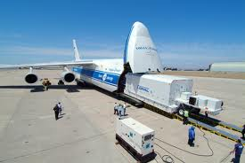
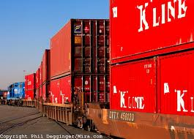
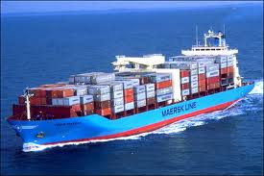
Shipping
Presentation by Al Elste, Traffic Supervisor

Slide 6
Customer Service
Business Services Section
Transportation Services Department
Our focus is on providing good service

